Slide 1
Lecture 3: Energy Security

Slide 2
World electricity generation. 2020. Data: bp(2021).

Slide 3
ENERGY SECURITY
• Energy security can be termed as a country's availability of vital requirements for the well being of its population and ensuring sufficient supply of affordable energy during global crisis
• Energy security reduces the dependency for primary energy requirement on other nations
• It is essential for maintaining a good economic health of nation

Slide 4
WHY TO FOCUS ON ENERGY SECURITY
Russia —Ukraine conflict
Fears of world petroleum output slowdown in future
Increasing population
Monopoly of producers
Limited Resources

Slide 5

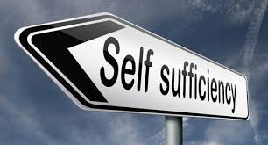


ANSWER TO ENERGY SECURITY

Slide 6
PRIME MOVERS OF THE ENERGY FUTURE
Demand
Growth
Security
of Supply
• GDP
• Population Growth
• Urbanisation
• Demand Management
• Significant Resources
• Non-conventional
Technology
and policy
Environmental Impacts
Supply
Challenges
• Local Pollution
• Climate Change
• Import Dependence
• Competition

